Slide 1


RLT Solutions Pvt Ltd
By RLT Group of Companies

Slide 2
Sub Contractor Evaluation Analysis
STP
WTP
ETP
DI

Slide 3


STP
Pre Qualification Requirement as per the requirement of YTIPL
Must have experience in construction and operation of domestic wastewater treatment (MBR process) with capacity ≥1000 KLD, and have passed approval and acceptance
RLT Submittals
YTIPL Cleared on 23.10.2025,

Slide 4
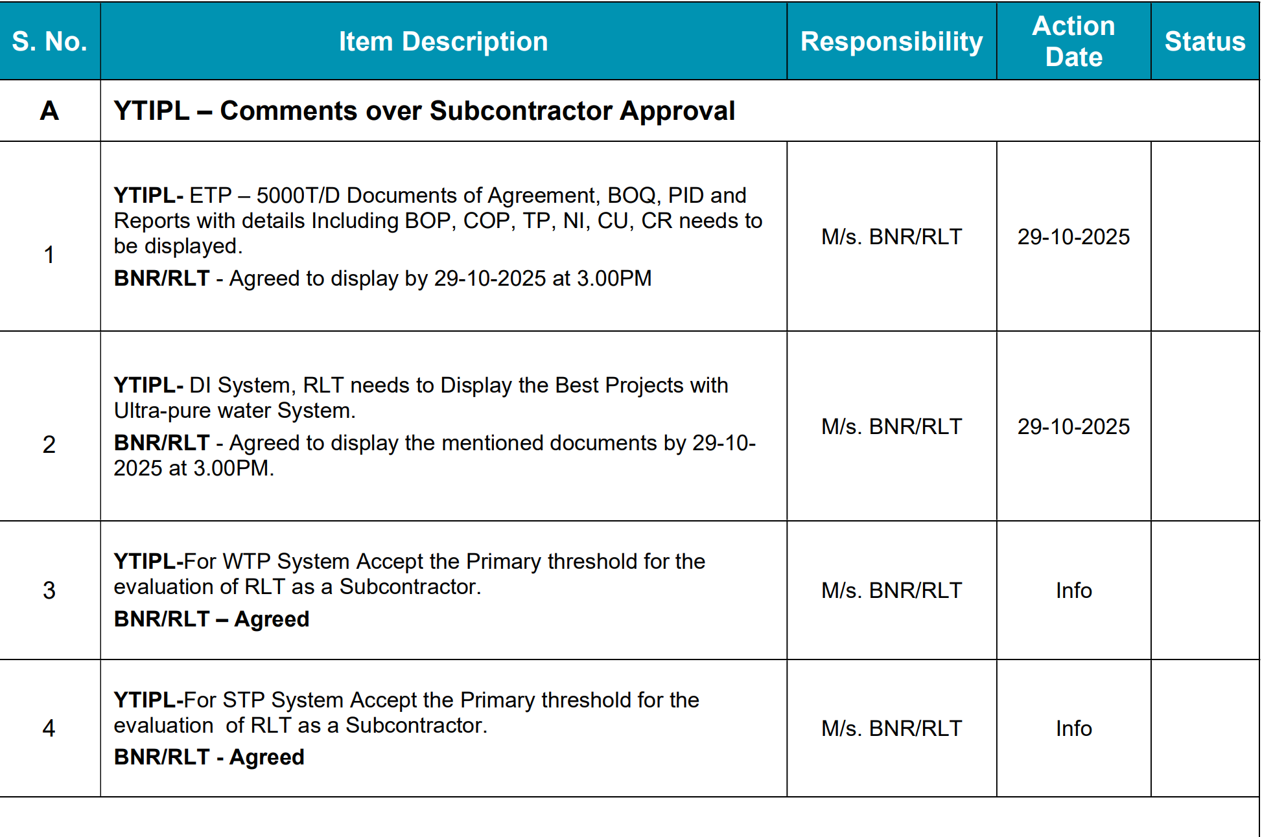
STP

Slide 5
WTP
Pre Qualification Requirement as per the requirement of YTIPL
Must have experience in construction and operation of ultra-pure water systems with daily water production capacity ≥3000KLD, and have no less approval and inspection. (If there is no experience in the above scale engineering projects, it is above scale engineering projects, it is required to have less than 3 projects with the water production capacity ≥1000KLD for ultra-pure water system construction and operation

Slide 6
WTP
RLT Submittals
Date: 23.10.2025
YTIPL not Cleared and requested for the following information P & ID, BOQs, Inlet & Outlet Characteristics
Date: 24.10.2025
YTIPL Cleared on 24.10.2025

Slide 7
ETP
Pre Qualification Requirement as per the requirement of YTIPL
Must have experience in construction or operating industrial wastewater with the capacity of ≥5000 KLD and Zero Liquid Discharge (ZLD) systems.
These Projects must have undergone official overview and acceptance approval. (including physic-chemical systems, biochemical systems, UF/RO membrane systems, and evaporation crystallization systems.) (If there is no experience in the above scale engineering projects, it is required to have no less than 3 projects with treatment capacity ≥2000 KLD for industrial wastewater and Zero Discharge (ZLD) construction and operation experience.)

Slide 8
ETP
RLT Submittals
Date: 23.10.2025
YTIPL not Cleared and requested for the following information P & ID, BOQs, Inlet & Outlet Characteristics
Date: 24.10.2025
YTIPL not Cleared and requested for the following information Inlet & Outlet Characteristics, Request to include Heavy metals, TP, BOD, COD, Ni, Cu, Cr
Date: 29.10.2025
YTIPL Cleared ETP

Slide 9
DI
Pre Qualification Requirement as per the requirement of YTIPL
Must have experience in construction and operation of ultra-pure water systems with daily water production capacity ≥3000KLD, and have no less approval and inspection. (If there is no experience in the above scale engineering projects, it is above scale engineering projects, it is required to have less than 3 projects with the water production capacity ≥1000KLD for ultra-pure water system construction and operation

Slide 10
DI
RLT Submittals
Date: 23.10.2025
YTIPL not Cleared and requested for the following information P & ID, BOQs
Date: 24.10.2025
YTIPL not cleared, requested for conductivity of < 0.1 mΩ
Date: 29.10.2025
Nuclear power plant kudangulam cleared, Thirumudivakkam not cleared due to typographical error in the document, and requested for similar work experience and the following to be submitted on 03.11.2025

Slide 11
RLT Submittals
DI
To be Submitted on Date: 03.11.2025

Slide 12
Addition & Deletion

Slide 13
WTP
ETP
DI

Slide 14
REQUIREMENTS

Slide 15
STP
Requirements

Slide 16
ETP
Requirements

Slide 17
WTP
Requirements

Slide 18
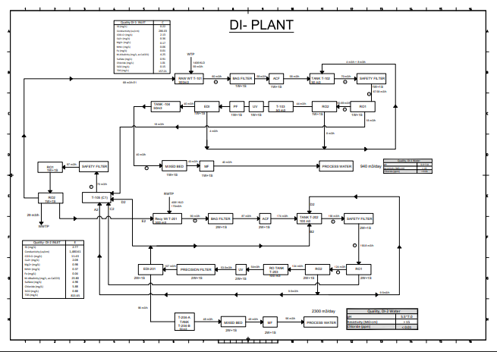
DI

Slide 19
DI
FEDI DESIGN-PERFORMANCE PROJECTION

Slide 20
DI
FEDI DESIGN-PERFORMANCE PROJECTION

Slide 21
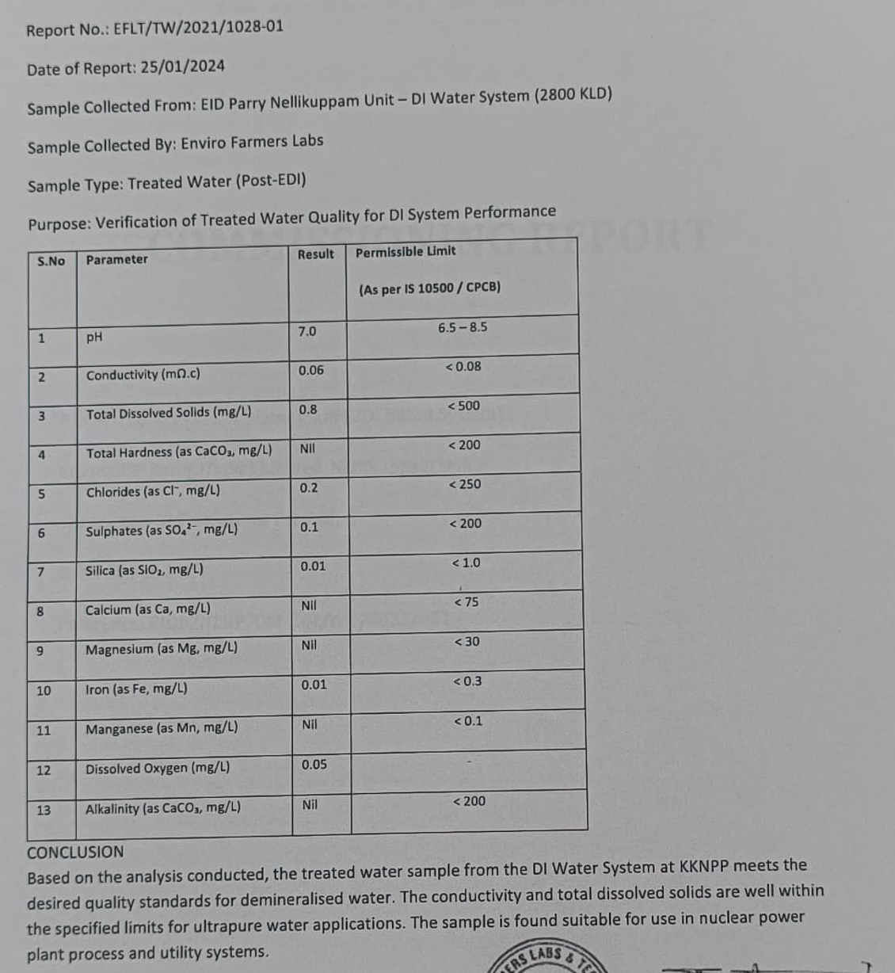
DI
Lab Report

Slide 22
Online Instruments

Slide 23
Online Instruments

Slide 24
DI REFERENCE LIST

Slide 25
Lab Instruments

Slide 26
Lab Instruments

Slide 27
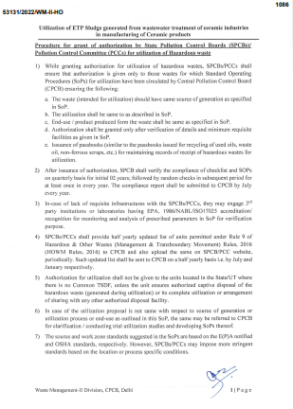
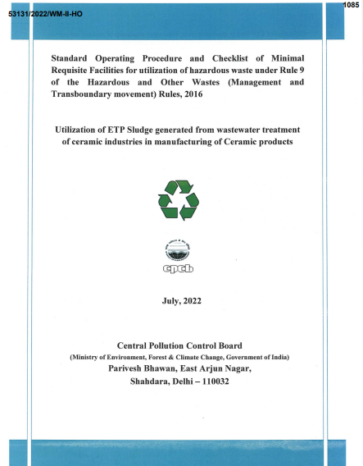
CPCB Checklist

Slide 28
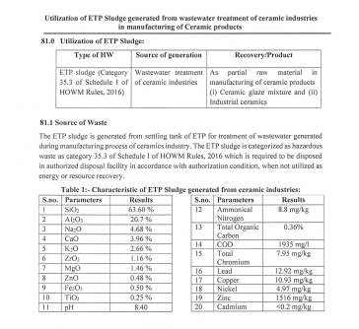
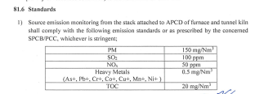
CPCB Checklist

Slide 29
Long Leads

Slide 30
Long Leads

Slide 31
Long Leads

Slide 32

“ We aim for the stars, with our feet firmly
on the ground.”
- RLT Solutions Pvt, Ltd Philosophy
At RLT Solutions Pvt Ltd, we believe that the path to excellence is paved one day at a time. With each milestone, we remain committed to learning, evolving, and consistently delivering greater value to our customers through innovative, practical, and reliable solutions.

Slide 33

Thank You
RLT Solutions Pvt Ltd
People Are Our Prime Movers | Since 2004.
93837 37064 | dm.contact@rltinst.net | www.rltsolutions.in

